Slide 1
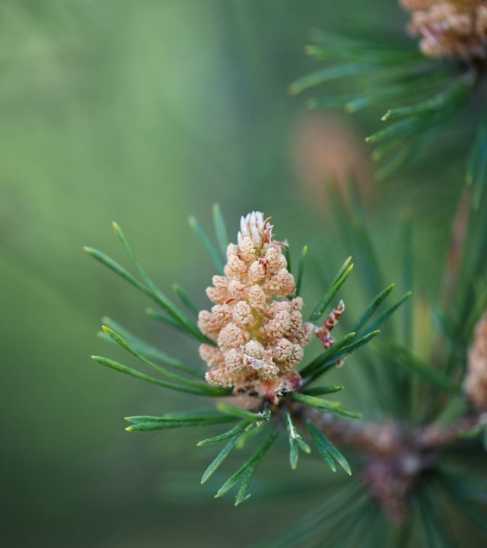
Rural and Traditional Arts Fellowship 2026

Slide 2
About us
We are thrilled to announce a partnership between New York State Council on the Arts and Shake on the Lake to provide funding for rural artists in 2026. This wide range of projects across rural New York represent the depth of artistic talent in our rural communities.
Funding for this project is made possible with support from the New York State Council on the Arts with support from the Governor’s office and the New York State Legislature.

Slide 3
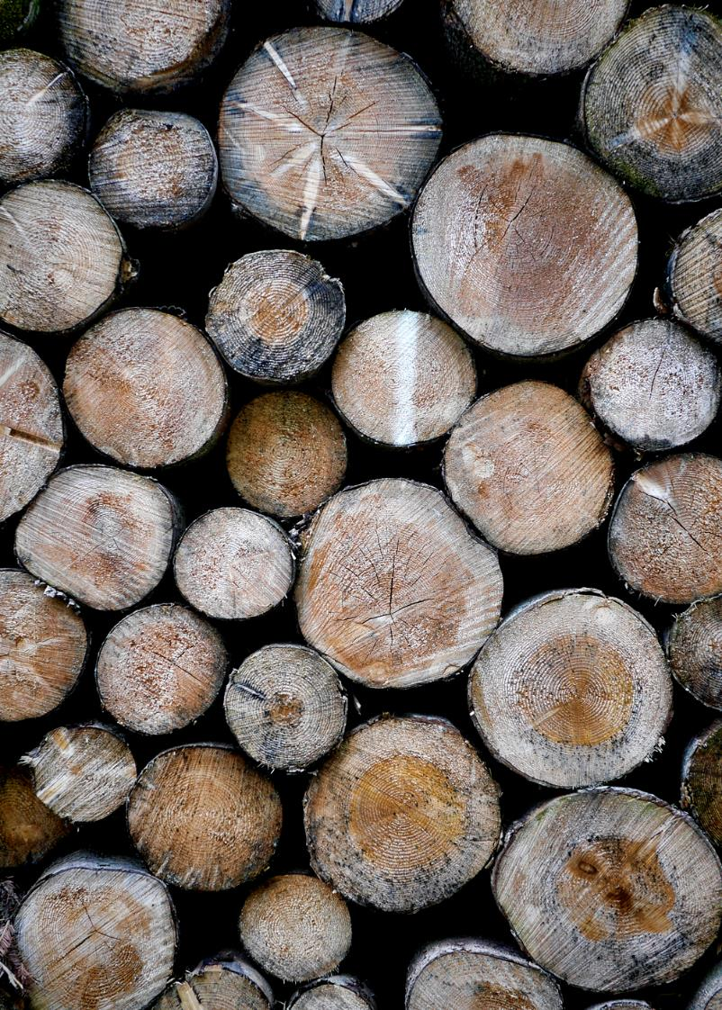
RTAF started as a conversation about what it means to be a rural artist

Slide 4
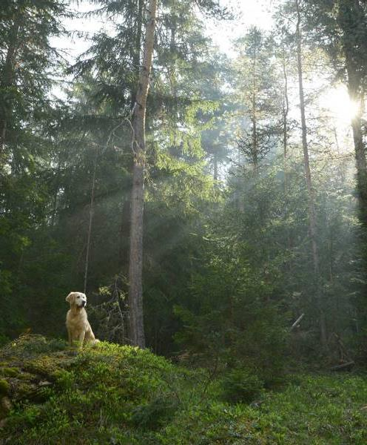
The Fellowship takes a place-based approach with the goal of inspiring and building lasting connections to rural people and places and to acknowledge and support artists living and working within rural communities. This project is meant to celebrate the creativity and innovative nature of the artist and the connection between arts and land in rural communities.

Slide 5
Award
Ten fellows in a wide range of artistic genres will be selected to represent their rural communities across New York State in 2026
Each will receive a $10,000.00 Fellowship

Slide 6

Application Deadline
Friday, February 20, 2026 at 4 PM

Slide 7
Eligibility
• Artists living and/or working in a rural community. For the purposes of this initiative, a rural community is defined as having populations of less than 25,000 and not part of an urban or suburban cluster.
• Artists working across disciplines are eligible. This can include individual artists, makers, and culture bearers who are committed to advancing the role of art, culture and creativity in rural development and community building.
• The project must demonstrate a deep commitment and place-based engagement with the artist’s rural community.
• Artists must propose an actionable idea that responds to, is inspired by, and/or engages with the land through their artistic practice. Artists may choose to work with a farm, a park or arboretum, a significant parcel of land, or another rural-based entity that is meaningful to the artist and their community.

Slide 8
What is covered
This Fellowship must culminate in a showing of a new work through a hybrid live/virtual presentation and/ or a traveling component to other rural communities. A cohort of 10 Fellows will be selected. The Fellowship provides a $10,000 award to support their existing work and to create a new work in response to their rural community. An additional $1,000 is included for actual travel expenses of the Fellow within NYS. The travel stipend may only cover travel related to project development, presentation of their work and cohort exchanges. Fellows should retain documentation of travel expenses and should generally not exceed the caps on NYS travel expenses described at https://bsc.ogs.ny.gov/before-your-trip.&nbsp;

Slide 9
ADDITIONAL Requirements
• Fellows are required to participate in the cohort components consisting of 2 artist in- person learning exchanges. These exchanges are meant to address challenges and successes the artists and communities are experiencing, and to discuss ways that artists can better support their work in community. There will also be monthly virtual check-ins that we encourage you to attend.
A final report

Slide 10
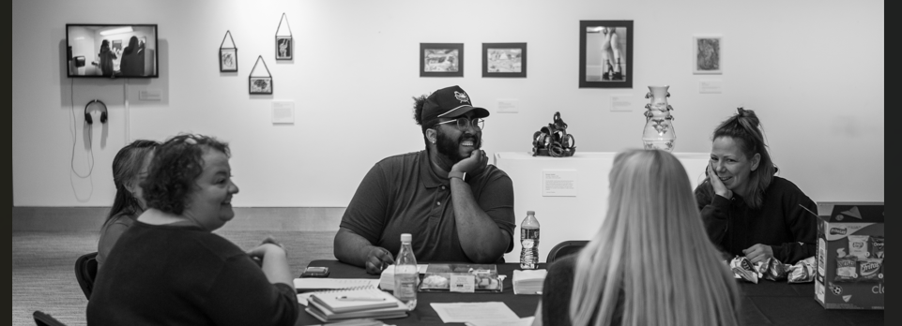
Questions?
Office hours will be available on our website later this week

Slide 11
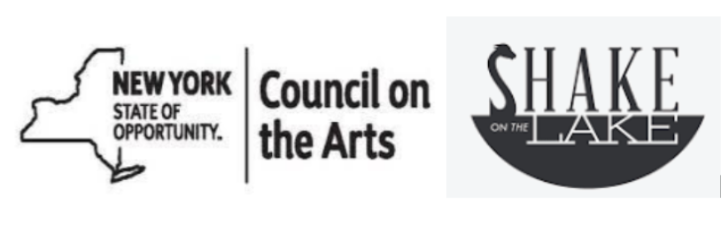
Thank you
Linda Franke
rtafcoordinator@gmail.com

